Slide 1


CAPSTONE PROJECT
E-COMMERCE REPORT ANALYSIS
Presented By
Student Name: SAMIA
College Name: JAMIA HAMDARD
Department: COMPUTER SCIENCE
Email ID: Samiakhan1697@gmail.com

Slide 2
OUTLINE:
Problem Statement
Proposed System/Solution
System Development Approach
Algorithm & Deployment
Result (Output Image)
Conclusion
Future Scope
References

Slide 3
Problem Statement:
In the modern digital economy, e‑commerce platforms have become one of the fastest‑growing business models, generating enormous volumes of transactional data every day. This data includes information about customer orders, product categories, regional sales, discounts, shipping preferences, and profitability. While the availability of such data is vast, businesses often struggle to manage and interpret it effectively.
The absence of structured analysis leads to several challenges:
Decision‑makers cannot easily identify which product categories or subcategories are driving the most revenue and profit.
Regional variations in sales remain hidden, making it difficult to allocate resources or plan targeted strategies.
Customer segments such as Consumer, Corporate, and Home Office are not clearly understood, resulting in missed opportunities for personalized marketing.
Discounts and shipping modes, which directly affect profitability, are not tracked in a way that reveals their true impact.
Traditional reporting methods are static and fragmented, forcing managers to rely on spreadsheets or basic summaries that do not provide real‑time insights. As a result, organizations face delays in responding to market changes, struggle to optimize operations, and risk losing competitive advantage.
The core problem, therefore, is the lack of an integrated, interactive, and visually engaging system that can transform raw e‑commerce data into meaningful insights. Without such a system, businesses are unable to fully leverage their data for strategic decision‑making, operational efficiency, and customer satisfaction.

Slide 4
Proposed Solution:
To address the challenges faced by e‑commerce businesses in analyzing and utilizing their vast transactional data, the proposed solution is the development of an interactive E‑Commerce Report Analysis Dashboard using Power BI. This system is designed to transform raw data into meaningful insights, enabling decision‑makers to monitor performance, identify trends, and optimize operations in real time.
Key Components of the Solution:
Data Collection
Gather historical e‑commerce data including orders, sales, profit, discounts, shipping modes, customer segments, and regional information.
Enrich the dataset with external factors such as seasonal demand, holidays, and promotional events.
Data Preprocessing
Clean and standardize the dataset to remove inconsistencies, missing values, and outliers.
Apply feature engineering to create calculated measures such as profit margin, discount impact, and regional contribution.

Slide 5
Dashboard Development
. Build KPIs for Total Orders, Sales, Profit, and Quantity.
. Use interactive visuals (bar charts, pie charts, treemaps, maps, gauges) to represent data across categories, regions, and customer segments.
. Implement filters and slicers (e.g., shipping mode, region, discount level) for drill‑down analysis.
. Add tooltips and bookmarks to enhance storytelling and user experience.
Deployment & Accessibility
Publish the dashboard on Power BI Service for collaboration and sharing.
Integrate with Azure Cloud for scalability and real‑time updates.
Ensure accessibility across devices for decision‑makers.
Value Addition
Provide insights into top‑performing categories, regions, and customer segments.
Highlight the impact of discounts and shipping modes on profitability.
Enable forecasting and scenario analysis using Power BI’s advanced features.

Slide 6
System Approach:
The development of the E‑Commerce Report Analysis Dashboard follows a structured approach to ensure accuracy, scalability, and usability. The methodology combines data preparation, visualization design, and deployment on cloud platforms for real‑time accessibility.
1. System Requirements
Software: Power BI Desktop for modeling and visualization, Power BI Service for deployment, Azure Cloud for scalability.
Hardware: Standard laptop/PC with Windows 10/11, minimum 8GB RAM recommended for smooth processing.
Data Source: Historical e‑commerce dataset (orders, sales, profit, discounts, shipping modes, customer segments, regions)
2. Libraries/ Tools:
Power Query (M Language) for data cleaning and transformation.
. DAX (Data Analysis Expressions) for calculated measures and KPIs.
Power BI Visuals Library for charts, maps, and dashboards.
: Methodology Import raw data → Clean and preprocess → Build relationships → Create KPIs and visuals → Deploy and share.

Slide 7
Algorithm & Deployment:
In the Algorithm section, we describe the analytical report on E-commerce. Here's an example structure for this section:
Algorithm Selection:
Descriptive analytics with Power BI; forecasting using built‑in models (e.g., regression, exponential smoothing)..
Data Input:
Orders, sales, profit, discounts, shipping mode, customer segment, region.
Training Process:
Data modeling in Power BI; relationships established; KPIs calculated using DAX..
Prediction Process:
Forecasting sales and profit trends; scenario analysis for discounts and shipping modes.
Deployment: . Dashboard published on Power BI Service; integrated with Azure for scalability and real‑time updates; accessible across devices

Slide 8
Result:
The dashboard provides clear insights into e‑commerce performance:
Sales by Category: Technology leads (~0.9M).
Profit by Subcategory: Copiers and Phones are top contributors.
Regional Sales: West region dominates (31.58%).
Customer Segments: Consumer segment contributes over 50% of sales.
Discount Analysis: Majority of orders placed without discounts, ensuring profitability.
The dashboard demonstrate its effectiveness in visualizing KPIs and trends.
~ FINAL PROJECT LINK : samiakhan1697-prog/E-Commerce-Sales-Dashboard-PowerBI: Power BI E-Commerce Sales Dashboard Capstone Project

Slide 9
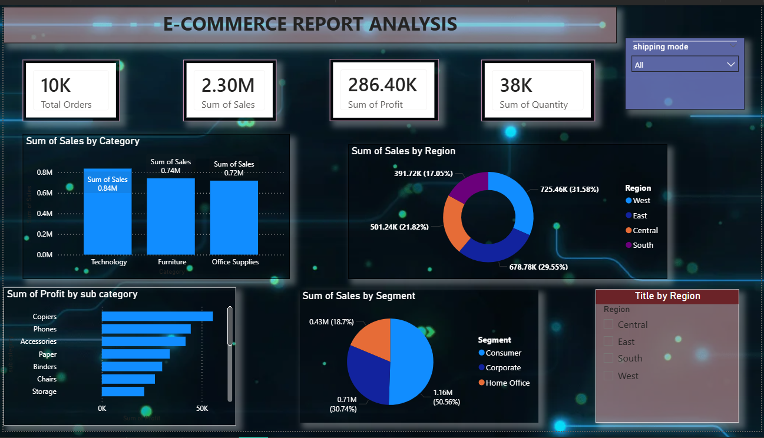
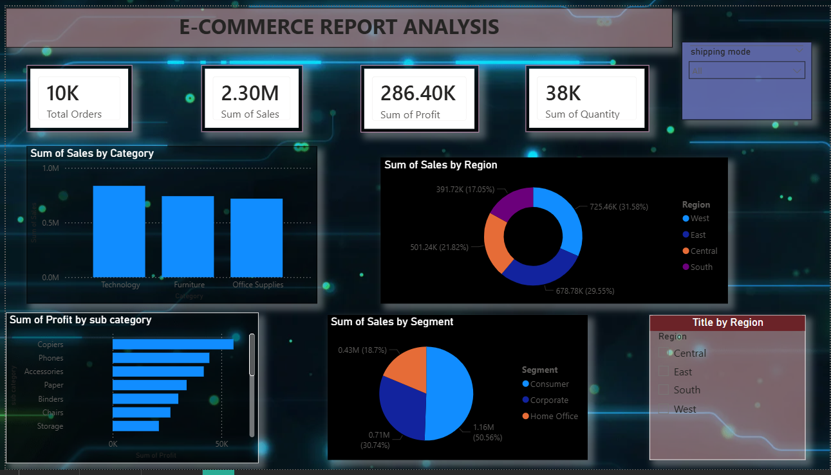
RESULT

Slide 10
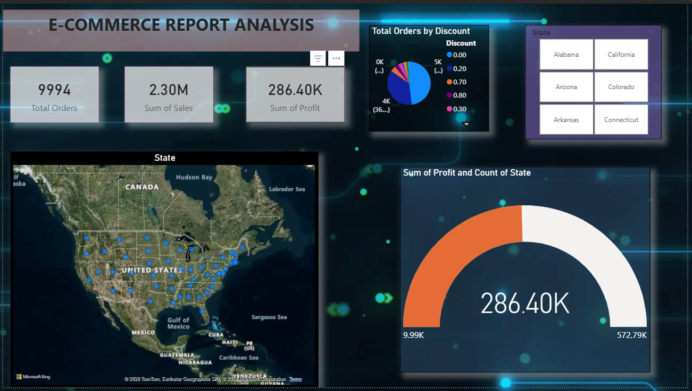
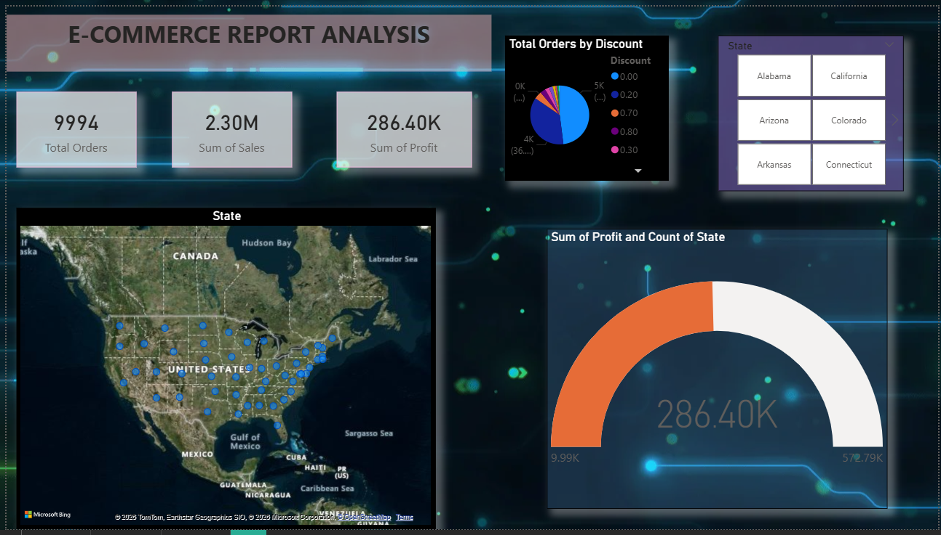
RESULT

Slide 11
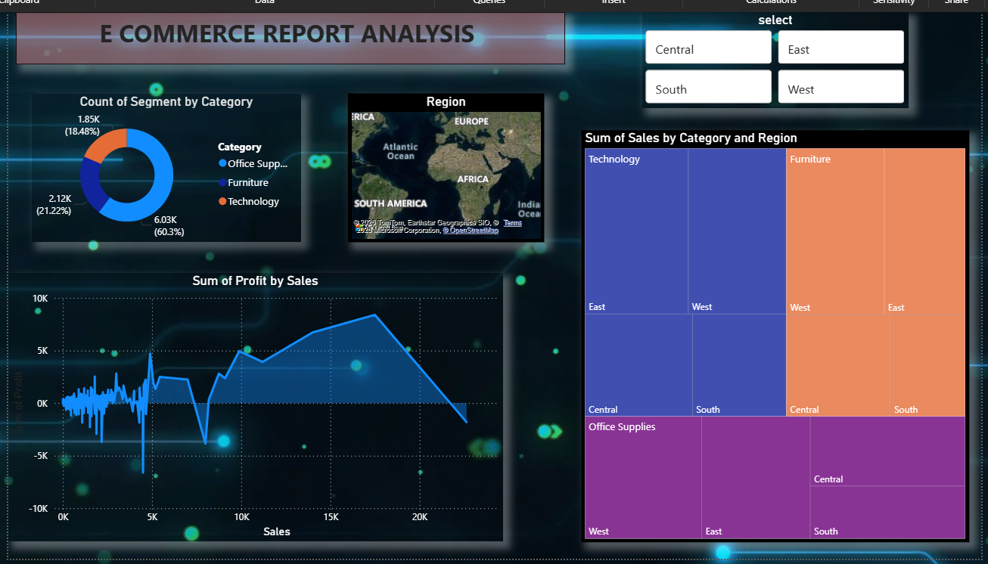

Slide 12
Conclusion:
The E‑Commerce Report Analysis Dashboard effectively demonstrates how raw transactional data can be transformed into actionable business insights. By consolidating sales, profit, orders, and customer segment information into a single interactive platform, the dashboard provides decision‑makers with a clear and comprehensive view of business performance.
Key findings highlight that the Technology category contributes the highest sales (~0.9M), while Copiers and Phones are the most profitable subcategories. Regionally, the West region dominates with 31.58% of total sales, and the Consumer segment accounts for more than half of overall revenue, emphasizing the importance of customer segmentation in strategy planning. The analysis also reveals that most orders are placed without discounts, ensuring profitability, while shipping modes play a significant role in customer satisfaction and cost management.
Beyond the insights, the project underscores the importance of data visualization and storytelling in modern analytics. Instead of static reports, the dashboard enables interactive exploration, allowing managers to drill down into specific categories, regions, or customer segments. This dynamic approach ensures faster, smarter, and more informed decision‑making.
Challenges encountered during development included handling data inconsistencies, designing user‑friendly visuals, and ensuring scalability for larger datasets. However, these challenges were addressed through Power Query preprocessing, DAX calculations, and deployment on Power BI Service with Azure integration.
Ultimately, this project proves that a well‑designed dashboard is not just a reporting tool but a strategic asset. It empowers businesses to identify growth opportunities, optimize operations, and enhance customer satisfaction, making data a driver of competitive advantage in the digital economy.
.

Slide 13
Future scope:
While the current dashboard provides strong descriptive analytics and forecasting capabilities, there are several opportunities to enhance and expand the system in future iterations:
Predictive Analytics Integration: Incorporating advanced machine learning models (e.g., regression, ARIMA, or LSTM) to forecast demand more accurately, such as predicting seasonal sales spikes or customer churn.
AI/ML Enhancements: Adding intelligent features like recommendation systems to suggest profitable product bundles or personalized offers for specific customer segments.
Expanded Data Sources: Extending beyond the current dataset to include external factors such as competitor pricing, marketing campaigns, or macroeconomic indicators, which would provide a more holistic view of performance.
Global & Multi‑City Deployment: Scaling the dashboard to handle datasets from multiple cities or regions, enabling comparative analysis across geographies and supporting global e‑commerce strategies.
Real‑Time Updates: Integrating with live data streams through Azure to provide real‑time monitoring of orders, inventory, and customer behavior, ensuring faster decision‑making.
Natural Language Interaction: Leveraging Microsoft Copilot or similar AI assistants to allow stakeholders to query the dashboard using simple language (e.g., “Show me last month’s profit by category”).
Edge Computing for Scalability: Exploring edge computing solutions to process data closer to the source, improving performance and accessibility for businesses with large, distributed datasets.
.

Slide 14
References:
Microsoft Power BI Documentation
Azure Cloud Administration Guides
Internship learning modules: Power BI, Azure, Cloud Engineering, AI/ML, Microsoft Copilot
Dataset: SampleSuperstore.csv.xlsx
Github link: https://github.com/samiakhan1697-prog/E-Commerce-Sales-Dashboard-PowerBI

Slide 15
Thank You

